Slide 1

Odoo Implementation for Printers' Company
Optimizing operations, boosting efficiency, and elevating customer satisfaction through a tailored Odoo ERP solution.

Slide 2

Project Overview
1
Objective
Optimize printer company operations through Odoo ERP.
2
Scope
Implement Odoo for sales, purchase, inventory, accounting, and CRM.
3
Expected Outcomes
Improve efficiency, save money, and enable data-driven decision.

Slide 3

Problem Statement
Outdated Systems
Hindering efficiency and data-driven decisions.

Slide 4
Proposed Solution
Technologies Used
Odoo ERP

Slide 5
System Architecture
Sales
1
Manage customer relationships, process orders, and handle invoicing.
2
Purchase
Manage suppliers, plan and execute purchasing activities.
Inventory
3
Track stock levels, manage warehouse operations, and handle returns.
4
Accounting
Handle financial transactions, generate reports, and manage tax compliance.
CRM
5
Manage customer relationships, track opportunities, and provide customer service.

Slide 6
Project Phases
Planning and Preparation
1
Conduct needs assessment and evaluate Odoo's suitability.
2
Data Migration
Extract, clean, transform, and load data into Odoo.
Configuration
3
Configure essential modules to match the company's workflows.
4
User Training
Develop training materials and conduct hands-on sessions.
Go-Live and Post-Implementation
5
Validate data, launch Odoo, and provide ongoing support.

Slide 7

Challenges and Mitigation Strategies
Data Quality
Ensure data accuracy and consistency during migration.
User Adoption
Develop strategies to encourage user adoption and overcome resistance to change.
Training and Support
Provide adequate training and support for effective Odoo usage.

Slide 8
Pros and Cons of Odoo Implementation
Pros
Cons
Streamline business processes for improved efficiency.
Users may need time to adapt to Odoo's interface and functionality.
Enhance data accuracy, accessibility, and reporting.
Accommodate business growth and expansion.
Potentially reduce operational costs and improve ROI.

Slide 9


Accounting Module Setup
by Menna Essam

Slide 10

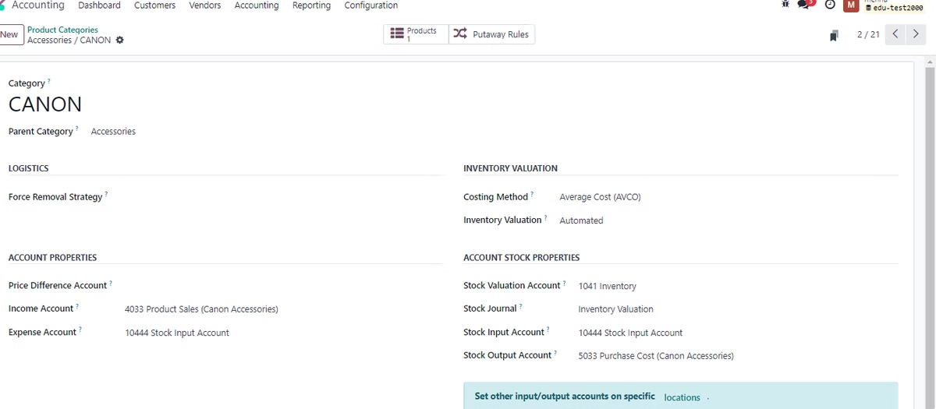
Accounting Module Setup
1
Install Accounting
Ensure the accounting module is installed and activated.
2
Configure Settings
Set up company details, product categories, and automatic accounting entries.
3
Chart of Accounts
Create accounts for assets, liabilities, equity, income, and expenses.

Slide 11
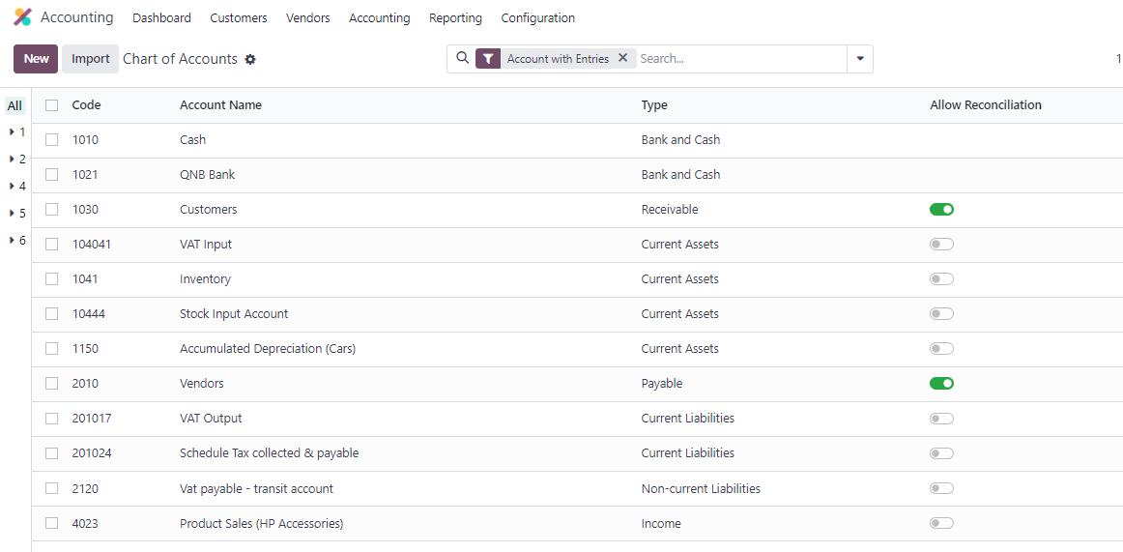
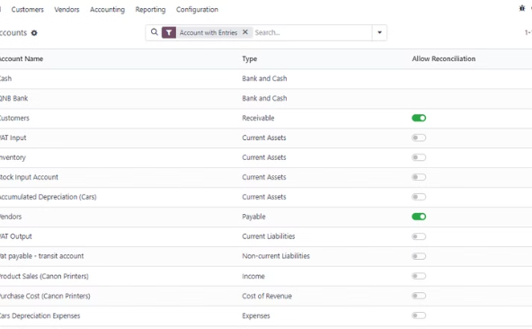
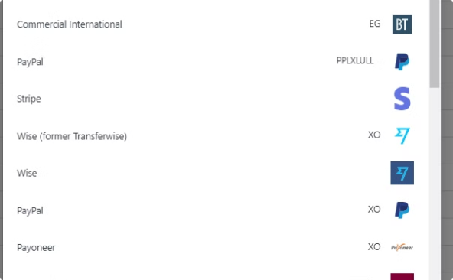
Accounting Module Setup
Chart of Accounts
Bank Accounts
Create accounts for different types of transactions.
Set up bank accounts for recording transactions.

Slide 12
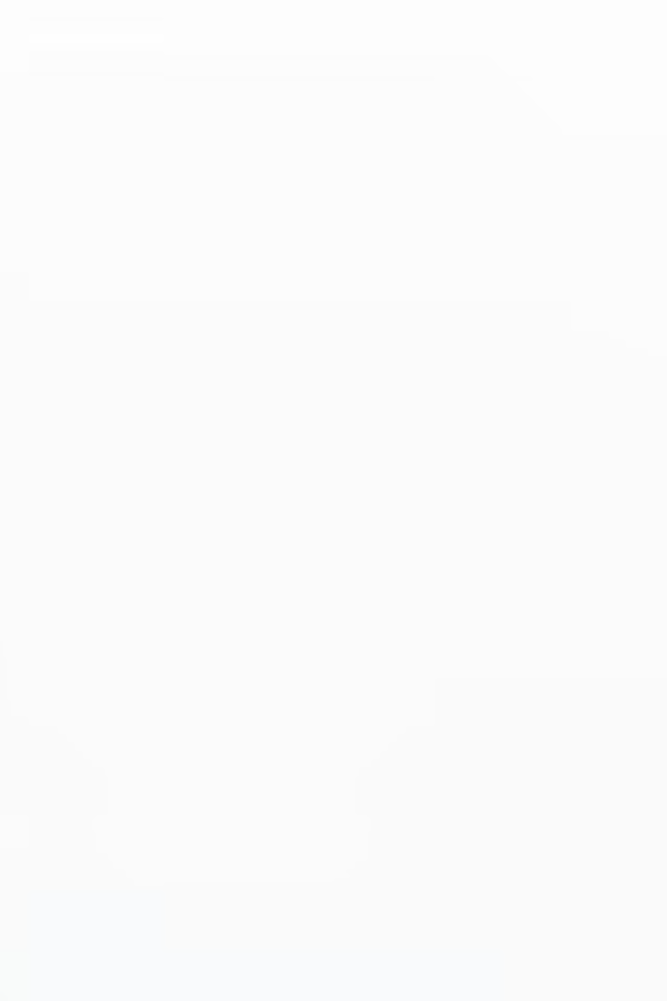
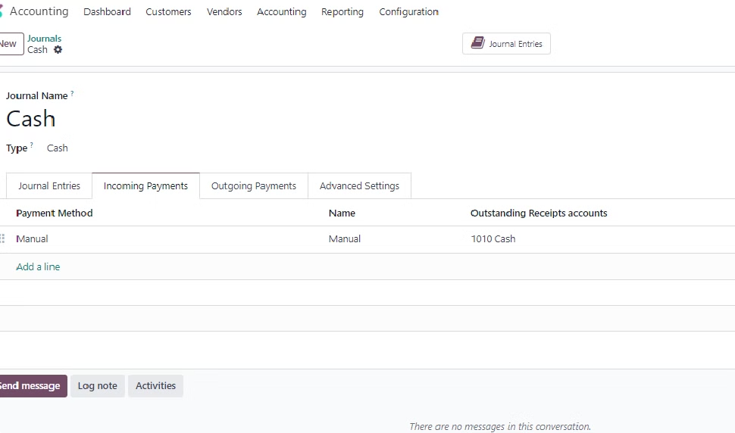
Accounting Module Setup
Journals
Create journals for different types of transactions.
Payments
Configure incoming and outgoing payments to be recorded directly.
Taxes
Set up tax configurations and enable cash basis accounting.
Fiscal Year
Define fiscal years and quarters for accurate reporting.

Slide 13

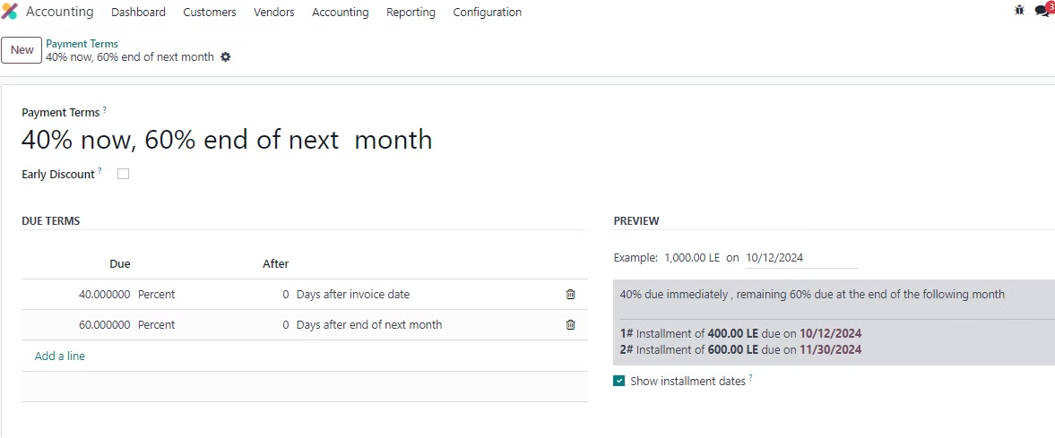

Accounting Module Setup
Payment Terms
Set deadlines, split payments, and offer discounts.

Slide 14

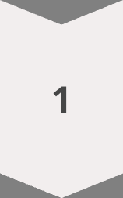


Additional Tips
Accounting Dashboard
Provides visual overview of financial performance.
Bank Reconciliation
Regularly reconcile bank statements for accuracy.
Financial Reporting
Generate customized financial statements.

Slide 15

Inventory Management System
Project Idea : Printers Merchandising Company – Al Ansar
Product Categories : Printers , Ink and Accessories

Slide 16
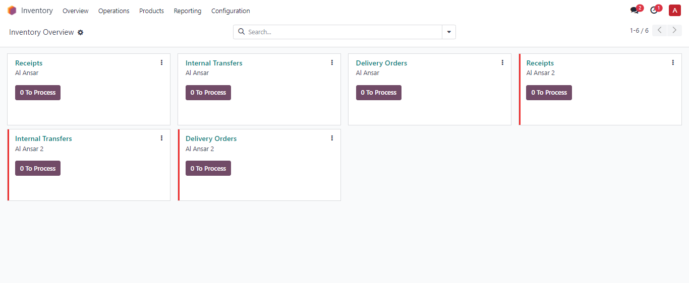
1- Inventory Dashboard
The basic inventory dashboard shows the available warehouses :
In our case there are two warehouses ( Al Ansar , Al Ansar 2 ) including three types of operations.
Below each operation it’s current status as an alert for the user to deal with it.
● Receipts : the upcoming products
● Delivery Orders : the Outgoing products
● Internal : any transfer between company’s warehouses

Slide 17
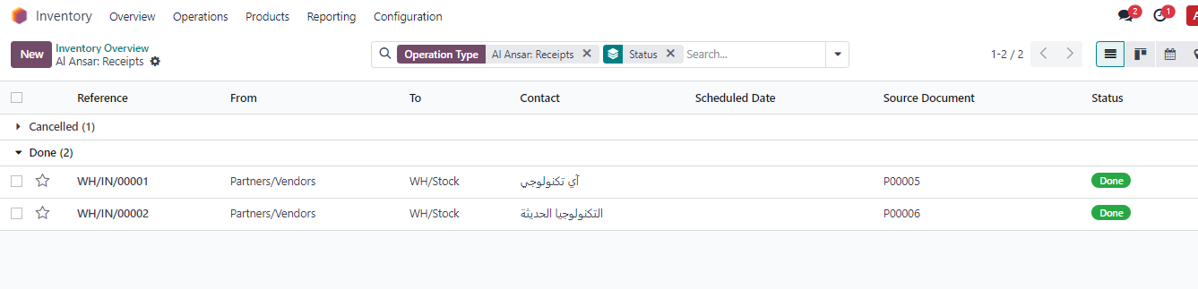
2- Inventory Receipts
Users Can Manage Received products and filter the receipts by it’s current status also view the
warehouse that will have the received products.

Slide 18
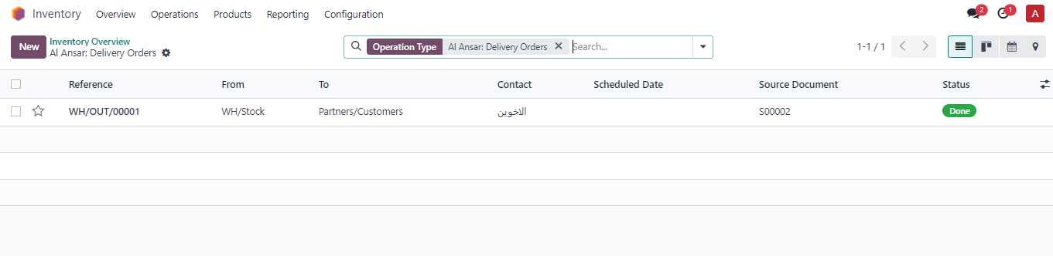
3- Inventory Delivery Orders
Users Can Manage Delivered products and filter the deliveries by its current status also view the
warehouse that will deliver the products.

Slide 19
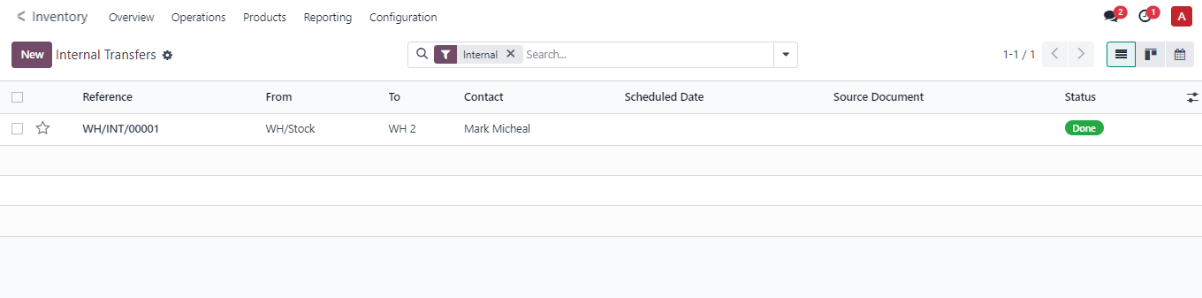
4- Internal Transfers
Internal transfers manages the operations between different warehouses

Slide 20
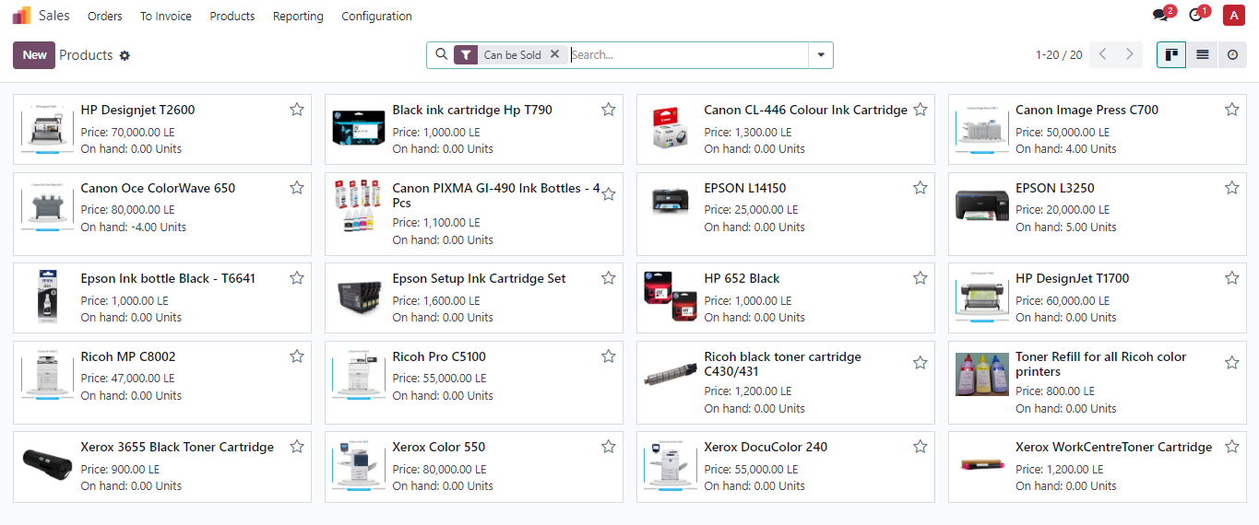
5- Products
This view shows the defined products along with their sale price and their quantity
on hand (which is the amount that is available in the warehouse)

Slide 21
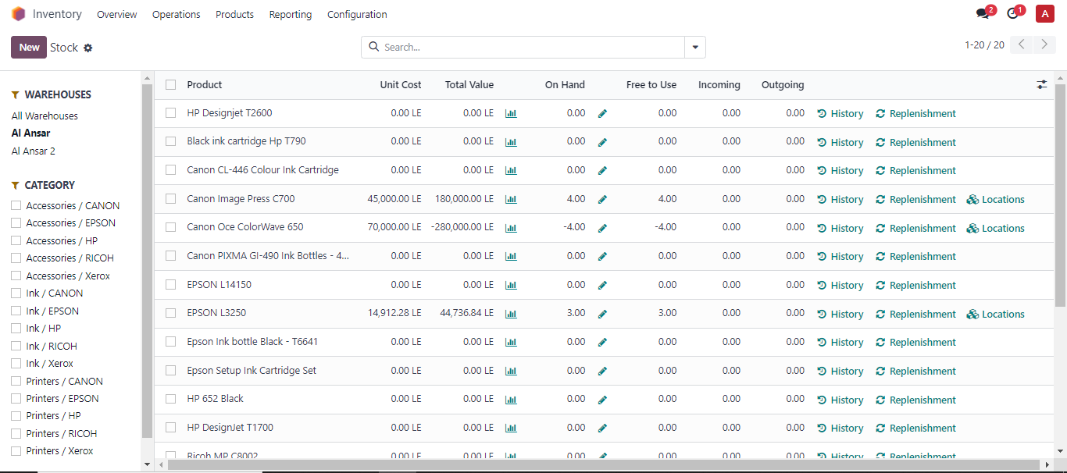
6- Stock
Users can view every product on hand quantity based on location , Also can filter
products by product category , warehouse and product type.

Slide 22
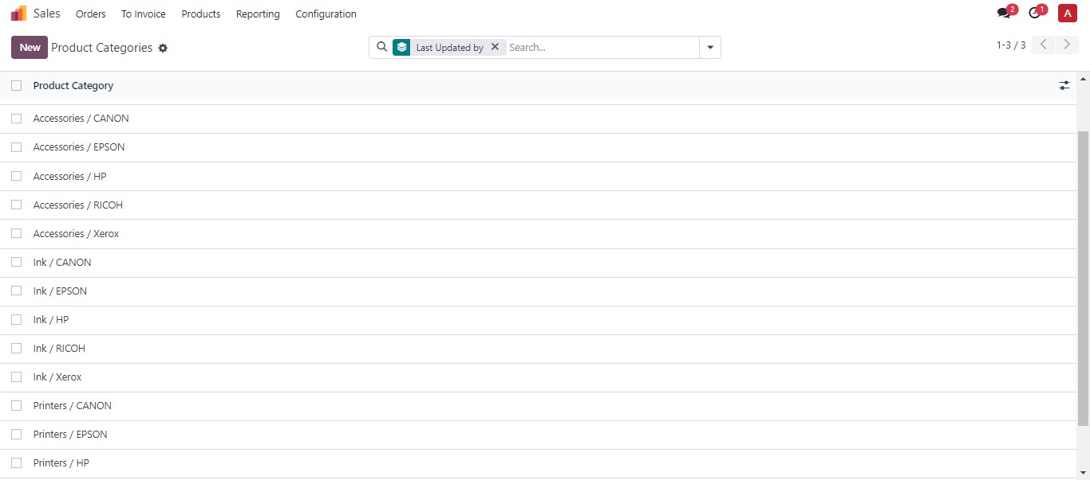
7- Product Category
Product categories not only categorize products with same properties , it’s used to
set the Stock valuation by using costing method as average or standard pricing .
Also accounting income and expense accounts are defined per Category.

Slide 23
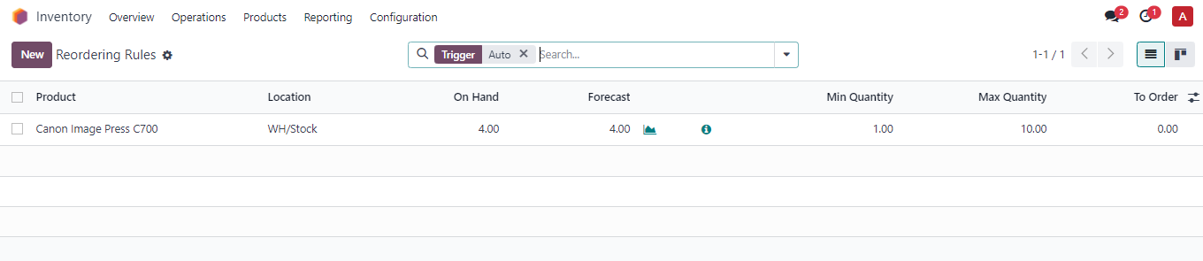
8- Reordering Rules
Users can set a purchase order for any product automatically if the current stock
reaches a minimum level that is used to be defined along with the maximum
quantity that should be the quantity on hand.

Slide 24
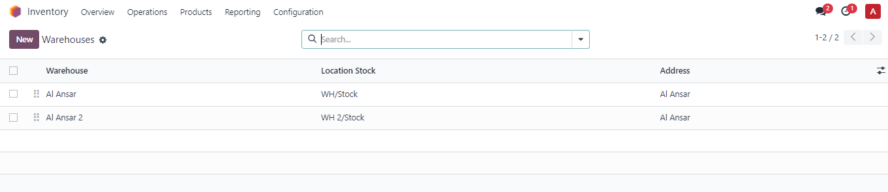
9 - Warehouses
Warehouse is used to be a subsidiary to main warehouse , by using the internal
operations , users can transfer storable products to each warehouse . Also they
can define multiple locations for each warehouse.

Slide 25


Purchase Documentation: Odoo Guide
This guide walks you through the purchase process in Odoo, from vendor creation to payment registration. You'll learn about each step, ensuring smooth purchasing operations within your Odoo system.
by Mohsen Khalaf

Slide 26

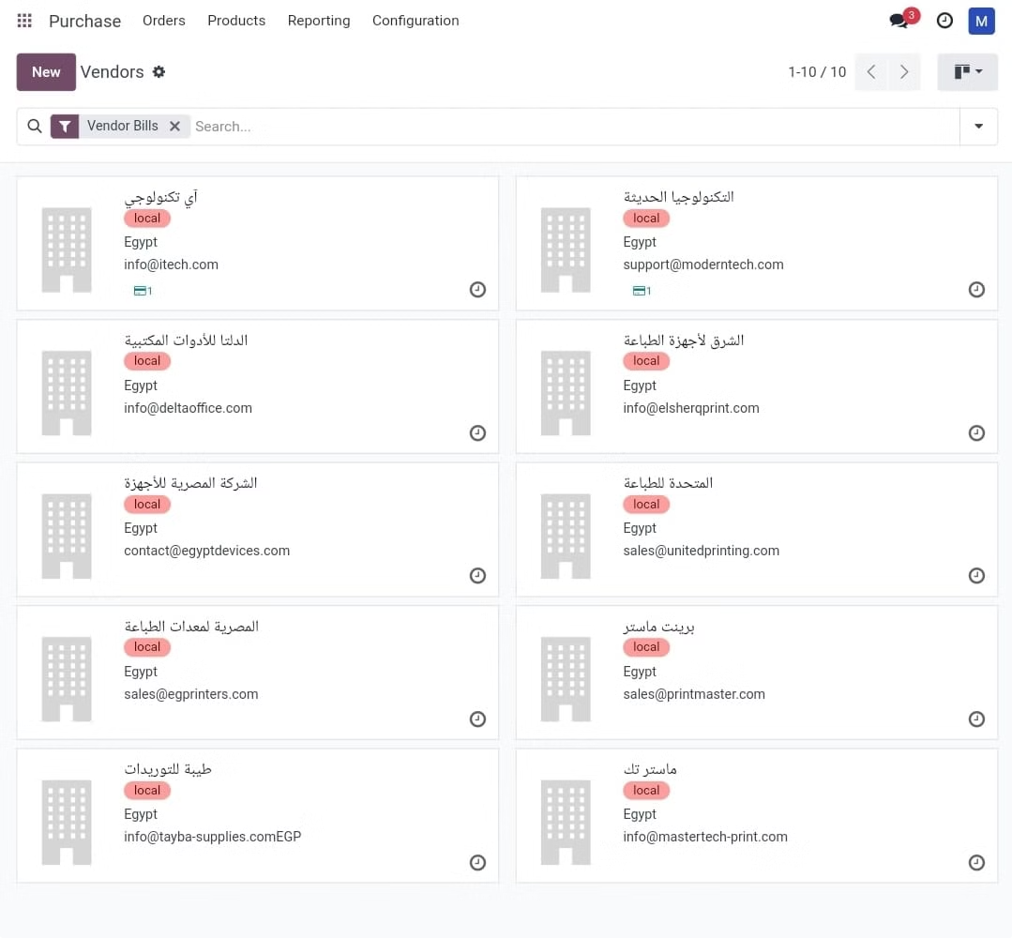
Vendor Creation
1
Access Purchase Module
Log in to Odoo and navigate to the Purchase module. This is where you'll manage all your purchasing activities.
2
Create New Vendor
Within the Purchase module, go to the Orders menu and select "Vendor" followed by "Create". This will open a form to create a new vendor.
3
Enter Vendor Details
In the vendor creation form, provide essential information such as vendor name, contact details, category, and payment terms. These details will be used for communication and accounting.
4
Save Vendor
After entering all the necessary details, click "Save" to register the vendor in the Odoo system. The vendor is now ready to be included in future purchase requests.

Slide 27

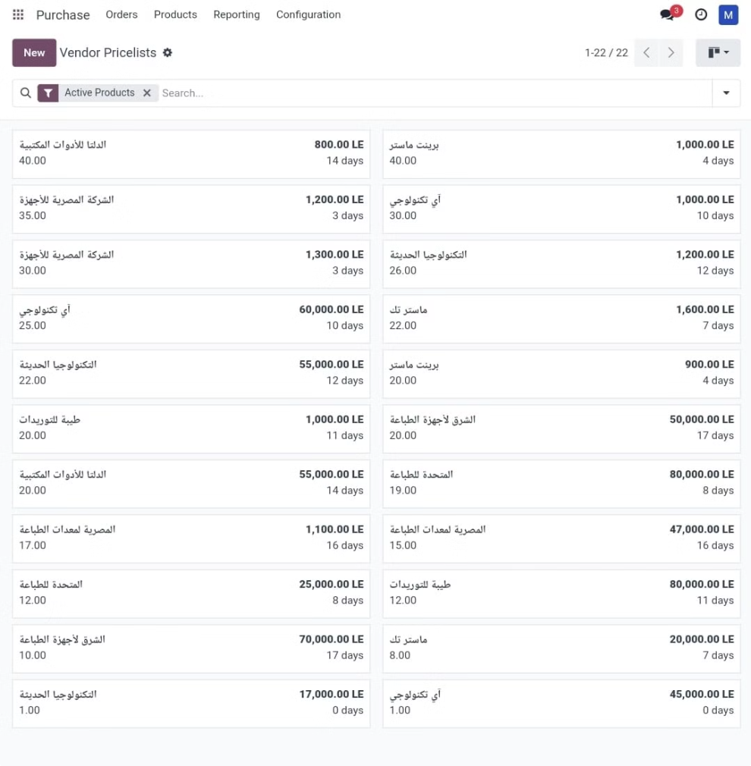



Vendor Pricelist Creation
Access Pricelist Menu
Navigate to "Configuration" in Odoo and select "Pricelist Vendor". This menu allows you to create and manage pricelists for your vendors.
Create New Pricelist
You can create a new pricelist manually by entering the product details and prices directly. Alternatively, you can import an Excel sheet containing vendor, product, price, and quantity information.
Save Pricelist
Once the pricelist details are entered, click "Save" to finalize the pricelist. This will store the prices and ensure they are readily available for future purchase orders.

Slide 28

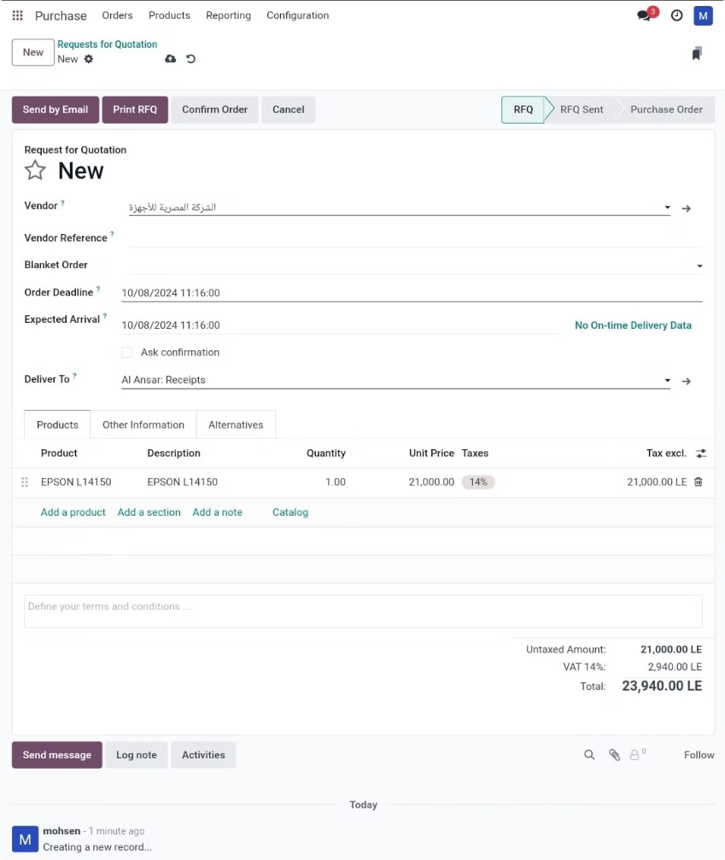
Request for Quotation (RFQ)
1
Create RFQ
2
Enter RFQ Details
Navigate to "Request for Quotation" in the Purchase module and click "Create". This action starts the RFQ process, where you'll request quotes from vendors for specific products.
In the RFQ form, specify the vendors you'd like to request quotes from, the products you need, and the required quantities. This information will be sent to the selected vendors.
3
Send RFQ
Click "Email by Send" to send the RFQ to the chosen vendors. The vendors will receive the request and provide their quotes based on the specified products and quantities.

Slide 29

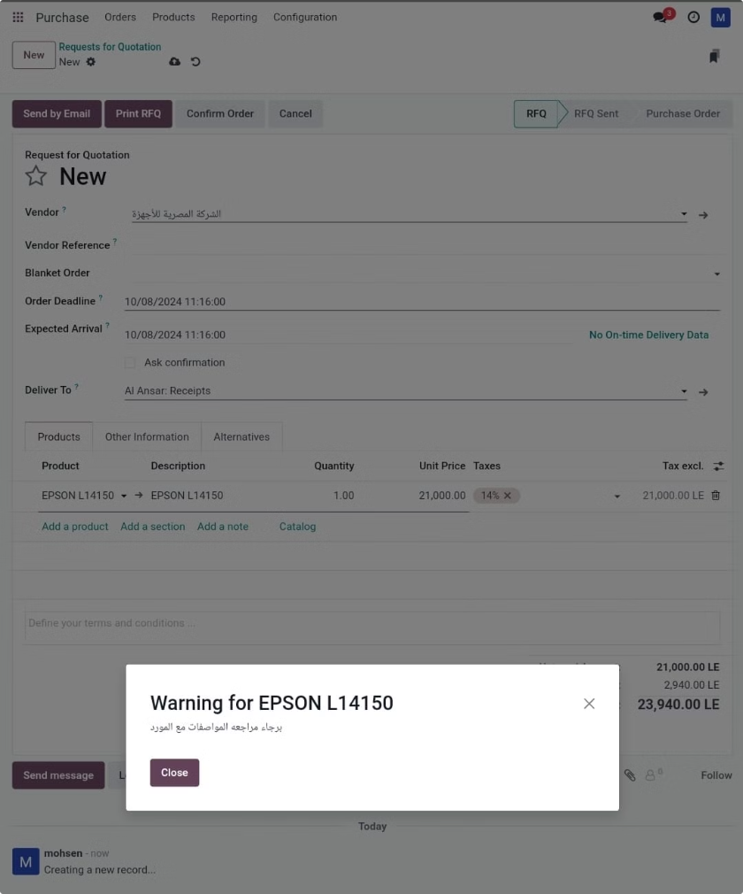
Warnings
Enable Warnings
Product Warnings
Create Warning Message
Go to "Configuration" in Odoo, then "Settings". Enable warnings and save the changes. This will activate the warning system for future purchase actions.
Navigate to the "Products" module. Select a product and go to the "Purchase" tab. This tab allows you to define specific warnings related to purchasing this particular product.
In the "Purchase" tab, add a warning message that will be displayed when the product is involved in a purchase order. For instance, you could add a message like "Please review product specifications with the vendor". After adding the warning, click "Save" to store the message.

Slide 30
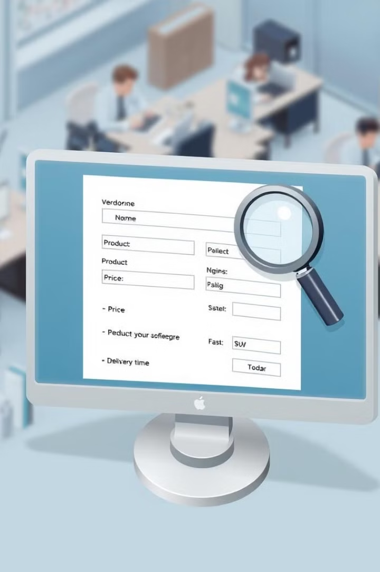



Quotation Receipt
Add Vendor Quotation
Open the RFQ you created and click "Vendor Add Quotation". This action allows you to enter the quote received from a vendor.
Enter Quotation Details
Input the prices and terms provided by the vendor in the dedicated section. This is where you capture the vendor's offer.
Save Quotation
After entering the quotation details, click "Save" to record the vendor's quote. This information will be stored within the RFQ and used for comparison with quotes from other vendors.

Slide 31

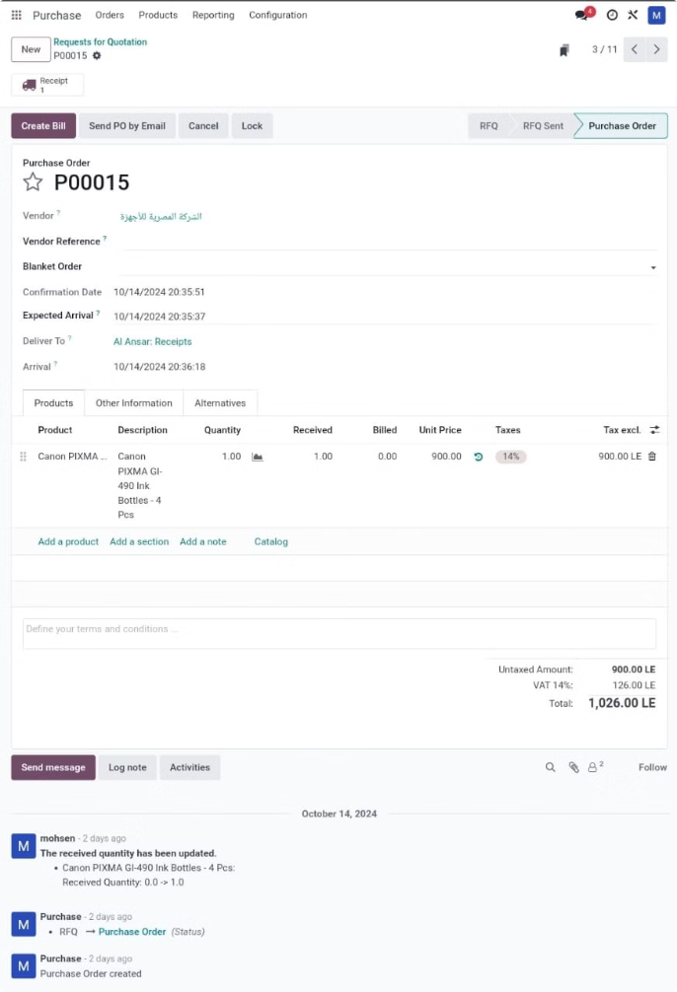
Purchase Order Creation
Convert RFQ to Purchase Order
Save Purchase Order
Click "Save" to finalize the purchase order. This action creates the official document that outlines the terms of the agreement with the selected vendor.
After receiving and saving quotations from all vendors, select the best offer. Then click "Order Confirm" to convert the chosen quotation into a purchase order.

Slide 32

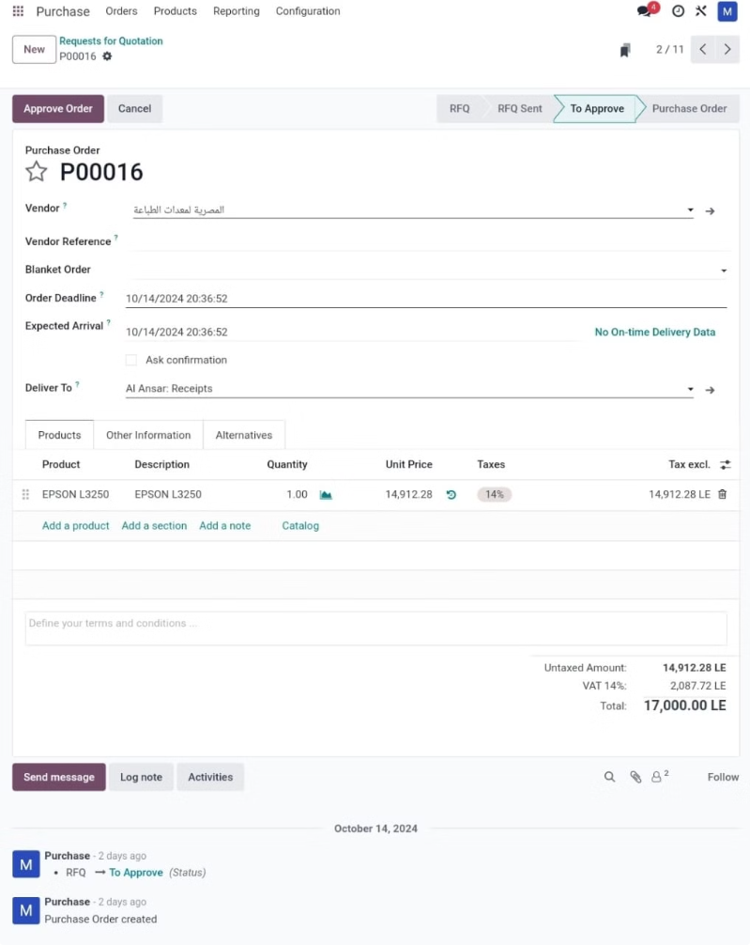
Purchase Order Approval
Step
Action
1
Go to the "Purchase Orders" list within the Purchase module. Review the details of the generated purchase order to ensure all the information is correct.
2
After verifying the purchase order details, click "Approve" to authorize the purchase. This step signifies your approval of the order and initiates the procurement process.

Slide 33

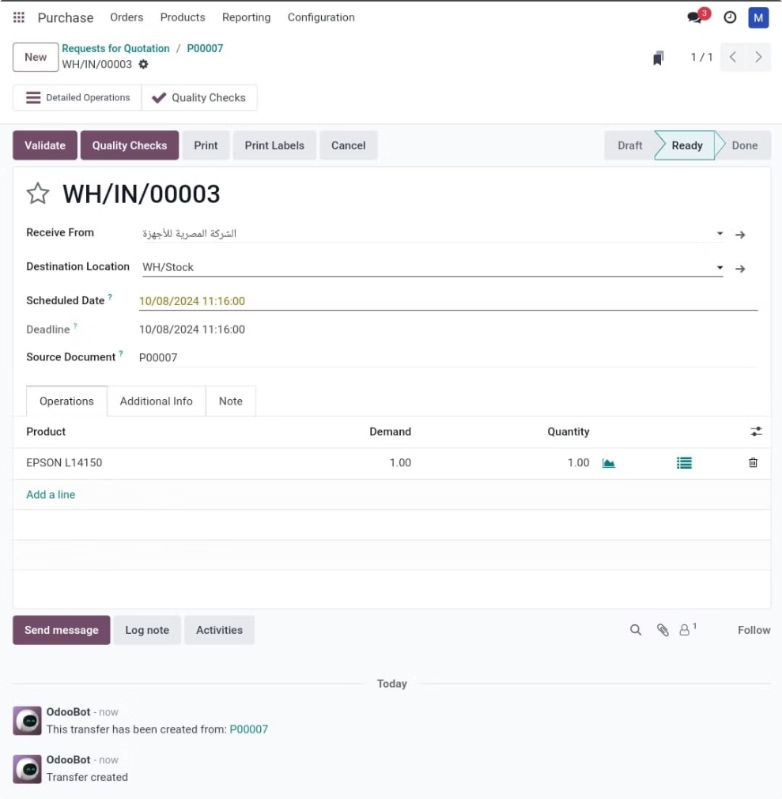
Receipt of Goods
1
Confirm Goods Receipt
Navigate to the "Inventory" module in Odoo and select "Receipts". This is where you'll manage the receipt of goods purchased through purchase orders.
2
Receive Products
Find the relevant purchase order in the "Receipts" list and click the "Receive Products" button. This action will open a form to record the actual receipt of the goods.
3
Review Received Quantities
Enter the quantities of products actually received in the form. This step ensures the record reflects the actual goods received. Finally, click "Validate" to confirm the goods receipt.

Slide 34

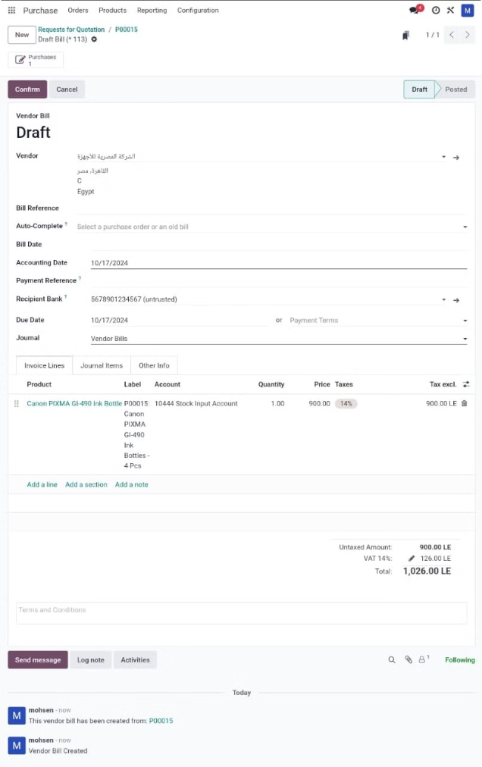
Vendor Bill Creation
Step
Action
1
Navigate to the "Vendor Bills" menu in the Purchase module and click "Create". This will open a form for creating a new vendor bill.
2
In the bill creation form, select the associated purchase order for which you are creating the bill. Then, enter the necessary details, such as the bill date, vendor, and any additional information.
3
Carefully review the bill details to ensure they match the purchase order. Once everything is correct, click "Validate" to finalize the bill.

Slide 35
Sales Module

Slide 36
Items Sales Module Implementation
Create sales Order Quotations.
Create Margin.
Create Pricelists.
Create Discounts & Gift Card.
Shipping Methods.
Order To Invoice.
Order To Upsell.
Create Discounts.
Lock Confirmed Sales.
Sale Warnings and Blocking Messages (Customers, Products).
Sales Reporting.

Slide 37
Create sales Order Quotations
Orders>> Quotations (Add Information, Add a section) >> send By Email>> Confirm
Pdf Quote, Quotation / Order

Slide 38
Create Margin
Configuration>>Setting>>Margins

Slide 39
Create Pricelists
Configuration>> Settings>>Pricelist
Products>>Pricelist

Slide 40
Create Discounts & Gift Card
Products>>Discount & loyalty>>NEW (Add Information) >>Generate Coupons
(Coupons Discounts) Products>>Discount & loyalty>>New
Coupons>>Coupon Code>>Add Coupon in Sales quotation

Slide 41
Shipping Methods.
Configurations>>Settings>>Delivery Methods
Configurations>>Shipping Methods>>new
Quotations>>Add Shipping

Slide 42
Order To Invoice
To Invoice>>order To Invoice

Slide 43
Order To Upsell
To Invoice>>order To Upsell

Slide 44
Create Discounts
Settings>> Check Discounts

Slide 45
Lock Confirmed Sales
Configuration>>Settings>>Lock Confirmed Sales

Slide 46
Sale Warnings and Blocking Messages (Customers, Products)
Configuration>>Settings>> sale Warnings
Orders>> Customers>> Internal Notes>> warning on the Purchase Order>> Warning>> (Warning, Blocking Messages)
Products>> Products>> Sales>> Warning When selling this product>> Warning>>(Warning, Blocking Messages )

Slide 47
Sales Reporting
Quotations>> (Group By Or Filter) >>SelesPerson
Reporting>>Sales
Reporting>>Customers

Slide 48

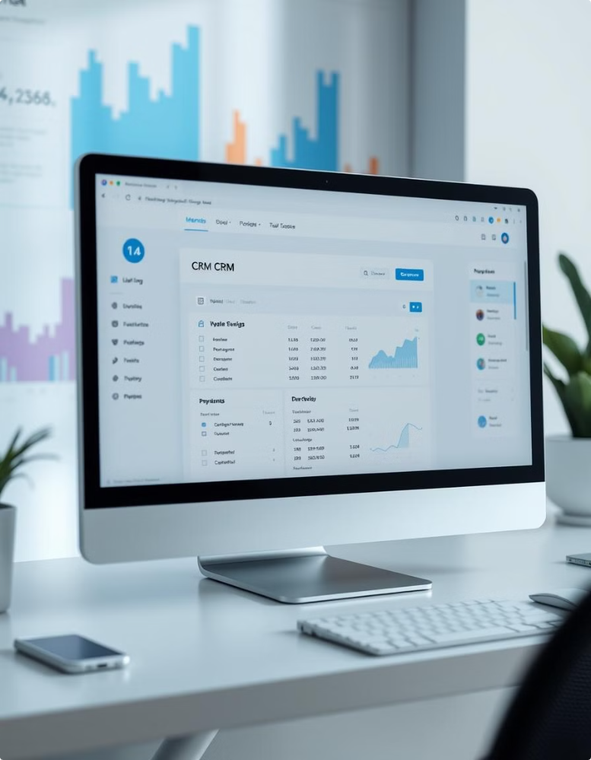
CRM Module Documentation
This documentation provides a comprehensive guide to using the CRM module, covering key features from setting up multi-teams and sales teams to managing leads, opportunities, and quotations. It also includes instructions on handling lost opportunities, utilizing activity plans, and generating reports.
By : Ali Abdelaal & Hassan Sayed

Slide 49

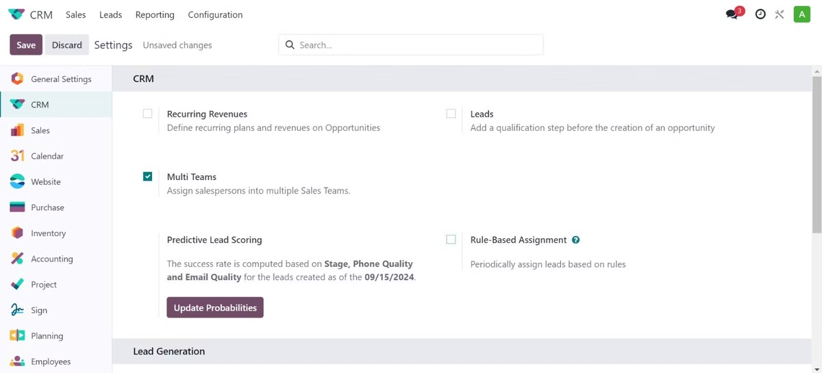
Activating Multi-Teams
1
2
3
Step 1
Step 2
Step 3
Go to Settings.
Navigate to Multi Teams CRM.
Select Configuration.

Slide 50
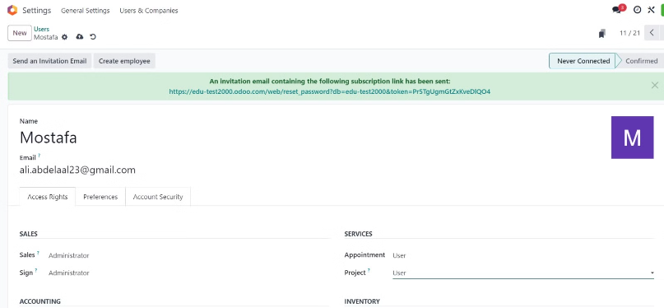
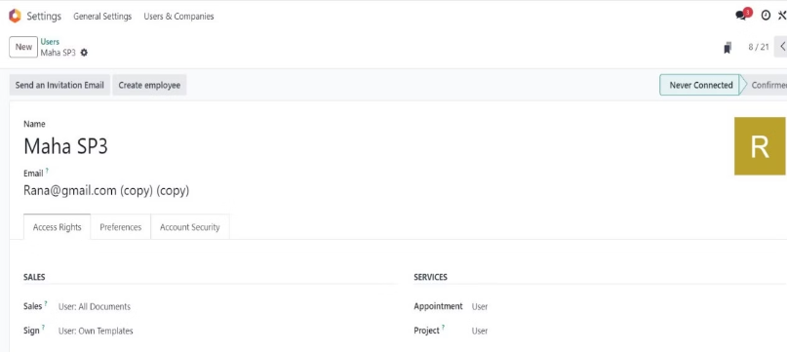
Setting Up Sales Teams
Adding Team Leaders
Adding Team Members
Go to Settings > Users & Companies > Users > New. Activate "Administrator" in Sales, ensuring no other department access.
Go to Settings > Users & Companies > Users > New. Activate "User: Documents" in Sales, ensuring no other department access.

Slide 51
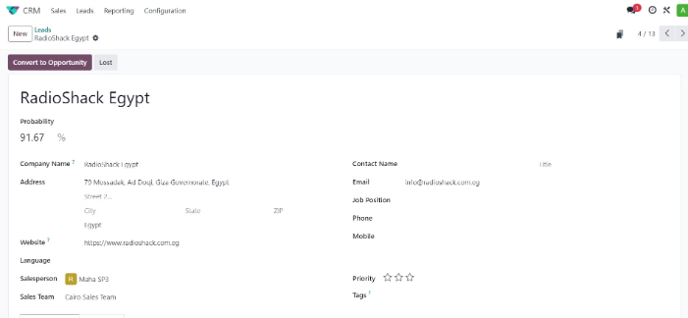
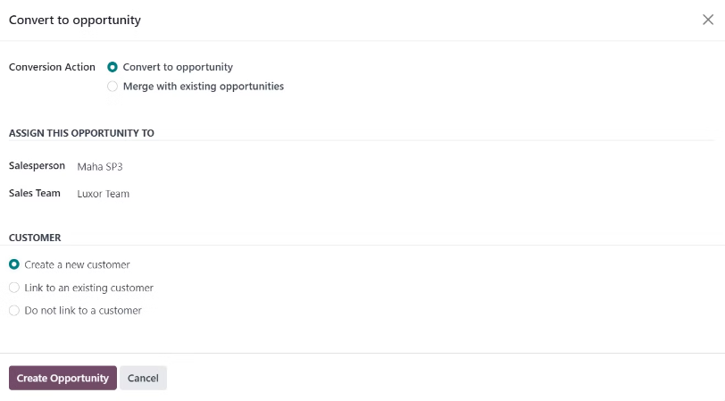
Creating and Converting Leads
Create a Lead
Go to CRM > Leads > New. Fill in the lead details, assign a salesperson and sales team.
Convert to Opportunity
Click "Convert to Opportunity" > "Create Opportunity". Fill in opportunity details like Expected Revenue and Expected Closing.

Slide 52

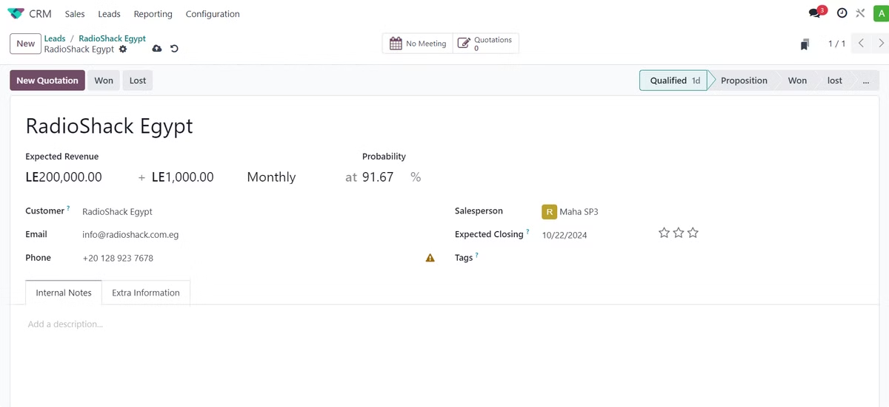
Managing Opportunities
Set the opportunity stage (qualified, proposition, won, lost). Create quotations by adding products, quantities, taxes, and payment terms. Confirm the quotation to convert it into a sales order.

Slide 53

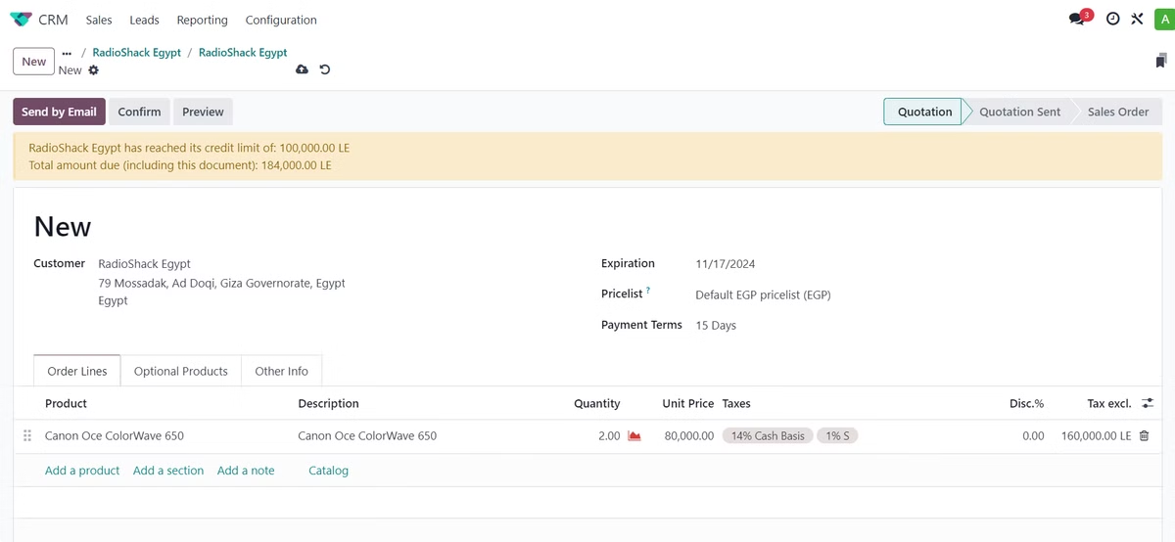
Creating Quotation
Then we click on New Quotation, and after that we add the products, quantity, taxes, and then we choose the payment period and click on Confirm.

Slide 54
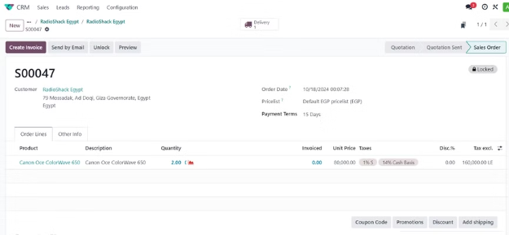
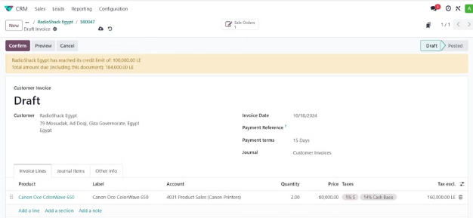
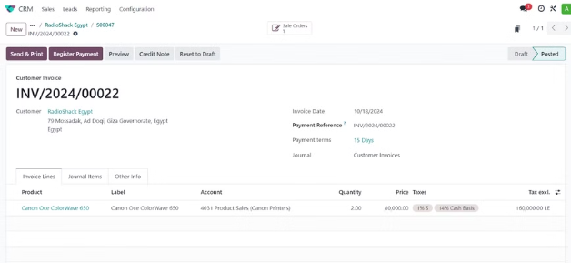
Creating Invoices
From the sales order, create an invoice by clicking "Create Invoice" and selecting "Regular Invoice". Confirm the invoice.

Slide 55
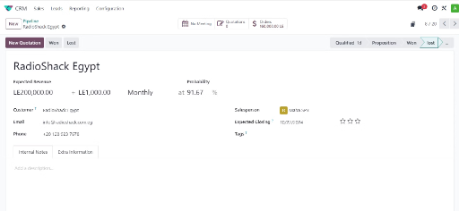
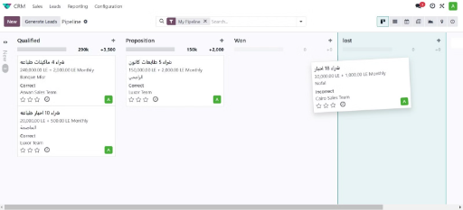
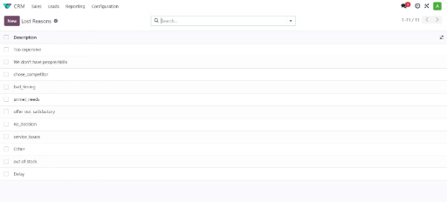
Managing Lost Opportunities
CRM > Pipeline
CRM > pipeline
CRM > Configuration > Lost Reasons
Click on the opportunity and mark it as lost.
Specify the reason for losing the opportunity.
adding or editing reasons under CRM app > Configuration > Lost Reasons.

Slide 56

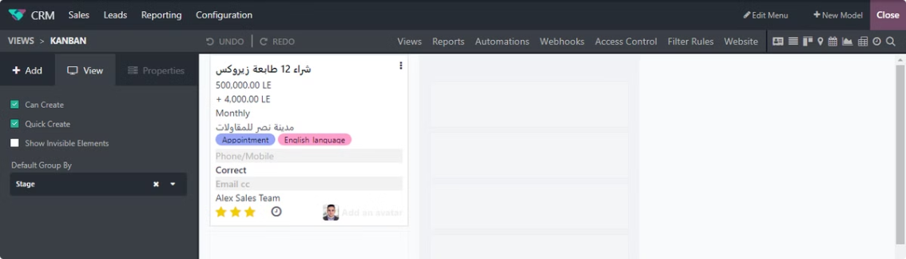
Odoo Studio and Kanban View
Use Odoo Studio Module to customize the interface, such as fixing filters and grouping by stage in the Kanban view for easier management.

Slide 57
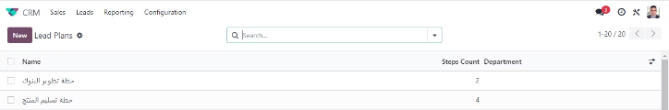
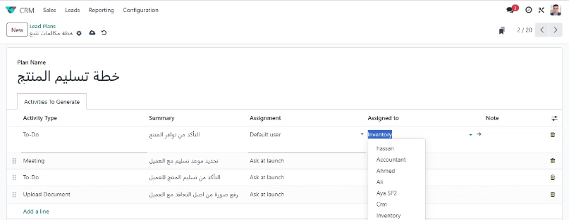
Activity Plans
CRM < Confegration < Activity Plans
We can make different plans for the mechanism of communication with customers through Activity plans.
CRM < Confegration < Activity Plans
Then we can add a plan mechanism by adding Lines and we can also specify the employee responsible for each step by selecting Default User from the Assignment box.

Slide 58
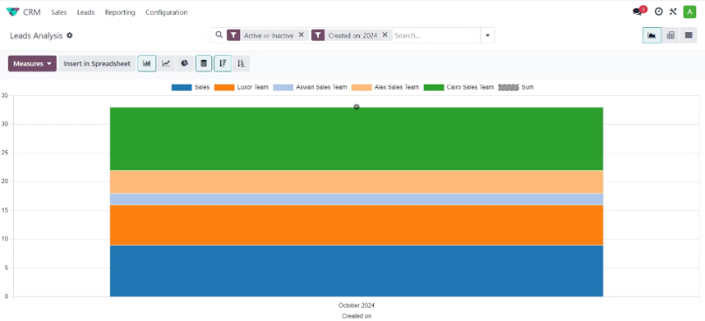
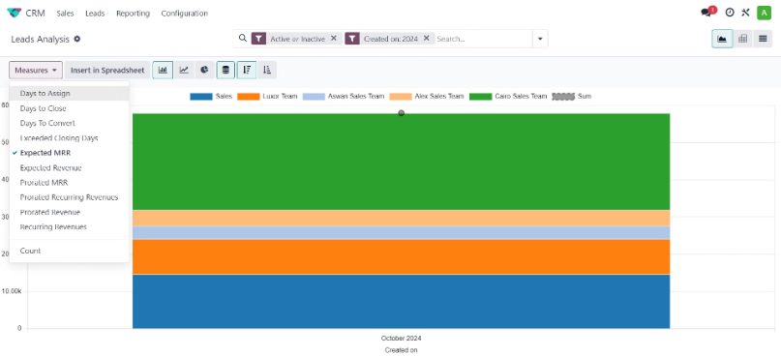
Reporting
CRM < Reporting < Leads
CRM < Reporting < Leads
Generate reports on sales teams and opportunities.
Customize reports to view KPIs and other metrics.

Slide 59
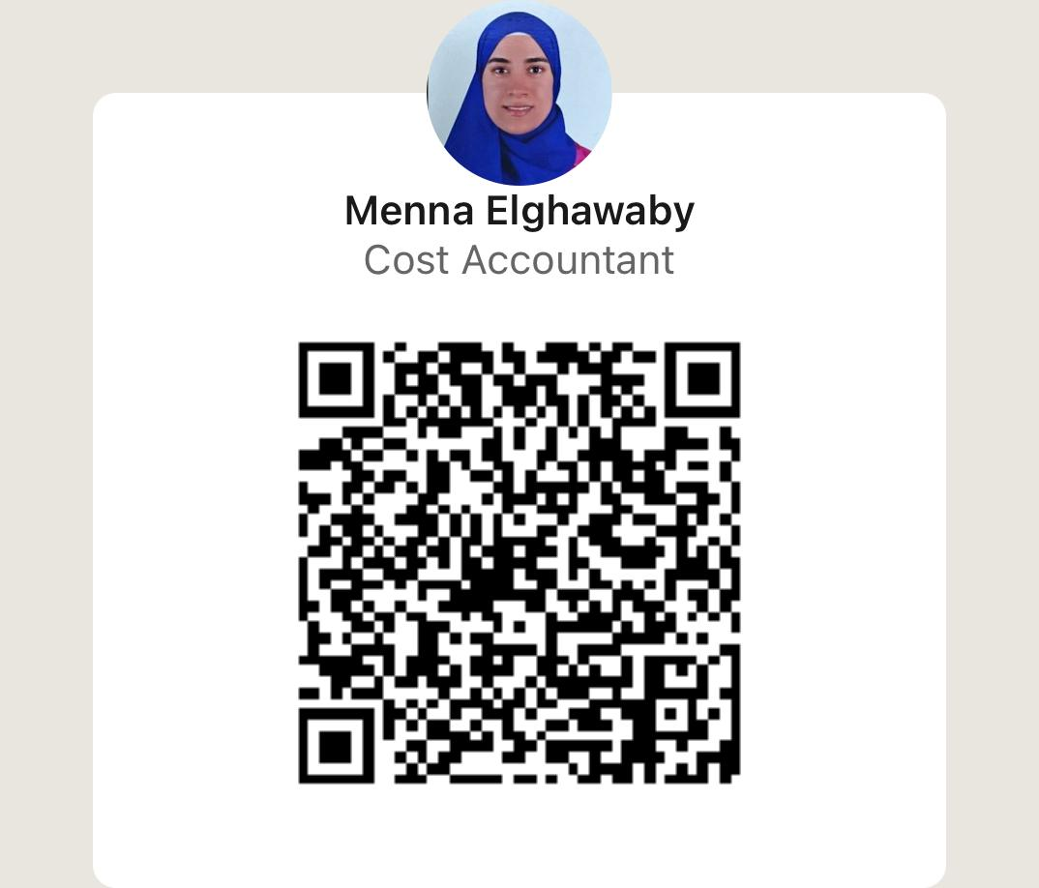
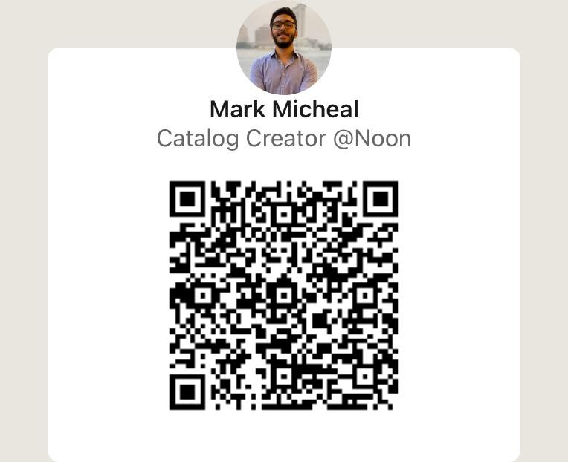
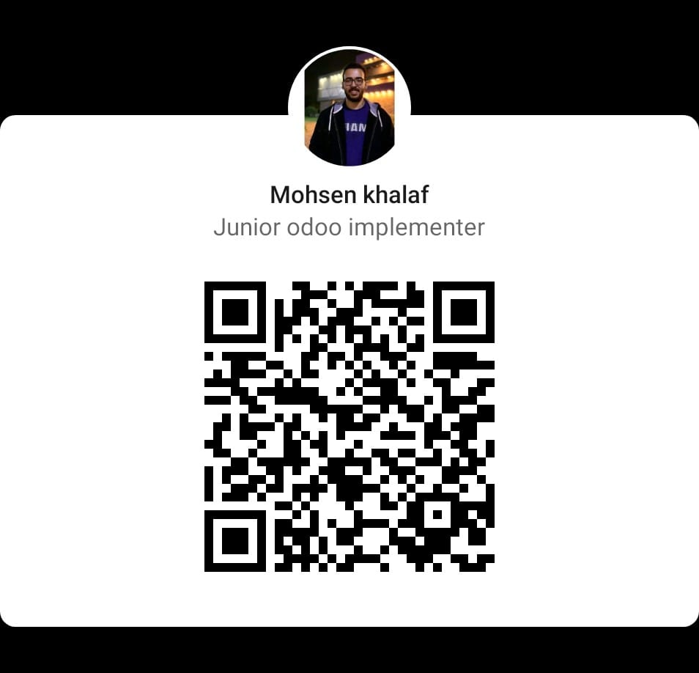
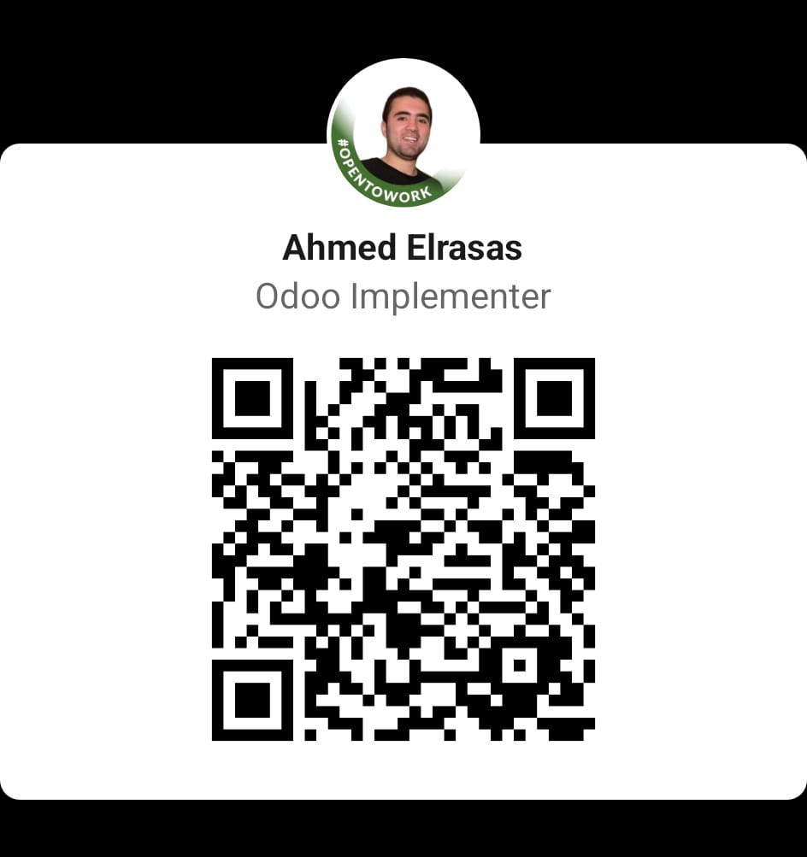


Thank You

